Slide 1
Lending Club Case Study
Upgrad lending club case study project

Slide 2
Table of Contents
The Problem
Domain, Context and Problem Statement
Decision Matrix
Dataset understanding
Assumptions
Challenges deep dive
Approach
Key Columns
Excluded Columns
Data preprocessing
Analysis (Univariate, Bivariate, Multivariate)
Inferences
Result
Recommendations
Team

Slide 3
The problem
Company
Context
Problem statement
There is a lending company which is the largest online loan marketplace, facilitating personal loans, business loans, and financing of medical procedures. Borrowers can easily access lower interest rate loans through a fast online interface.
Lending loans to ‘risky’ applicants is the largest source of financial loss (called credit loss). Credit loss is the amount of money lost by the lender when the borrower refuses to pay or runs away with the money owed. In other words, borrowers who default cause the largest amount of loss to the lenders. In this case, the customers labelled as 'charged-off' are the 'defaulters'.
Company wants to understand the driving factors (or driver variables) behind loan default, i.e. the variables which are strong indicators of default. The company can utilise this knowledge for its portfolio and risk assessment.
Main objective is to find variables in the dataset which influences for loan to be defaulted.

Slide 4
Decision Matrix
Loan Accepted - Three Scenarios
Fully Paid - Applicant has fully paid the loan (the principal and the interest rate)
Current - Applicant is in the process of paying the instalments, i.e. the tenure of the loan is not yet completed. These candidates are not labelled as ‘defaulted’.
Charged-off - Applicant has not paid the installments in due time for a long period of time, i.e. he/she has defaulted on the loan
Loan Rejected - The company had rejected the loan (because the candidate does not meet their requirements etc.).
Since the loan was rejected, there is no transactional history of those applicants with the company and so this data is not available with the company (and thus in this dataset).

Slide 5
Dataset Understanding
Dataset given contains the information about past loan applicants and whether they ‘defaulted’ or not.
Dataset contains information pertaining to the borrower’s past credit history and Lending Club loan information.
Dataset consisted of over 39717 records and 111 columns along with Data dictionary contains information about each column and their relevance.
Dataset reflects loans post approval, thus does not represent any information on the rejection criteria process.
Dataset has column `loan_status` which shows information such as:
Fully-Paid - The customer has successfully paid the loan
Charged-Off - The customer is “Charged-Off” ir has “Defaulted”
Current - These customers, the loan is currently in progress

Slide 6
Assumptions
loan_status is “Current” is not useful.
Binning (based on uniformed intervals)
Dropped Monotonous, ids (such as id, member_id) columns
Loan description and other free form columns such as title not related to each other and not considered for analysis.
Post loan approval columns are not considered for analysis

Slide 7
Challenges deep-dive
Challenge 1
Challenge 2
Challenge 3
Find relevant attributes
To find columns which are really significant for analysis and contribute to discover patterns.
Data Correction
Some of the columns has missing values and data is not in the correct format so data cleansing and standardization is needed. Neatly segregation of categorical and numerical columns.
Discover Relations in attributes
Once data will be in correct format then on remaining columns we need to do analysis and find patterns which affects `loan_status` variable with respect to other variables by using EDA (Univariate, Bivariate, Multivariate) Analysis.

Slide 8
Approach

Slide 9
Data Cleaning & Manipulation & handling Missing Values
Dropping Rows - where loan_status = “Current”
Analysis of the dataset post cleanup and standardization (Univariate, Bivariate, Multivariate analysis)
Data Preprocessing
Standardization
Analysis
Results
Data standardization and converting to correct data types and common functions to create plots and graphs and Metrics Derivation and Binning
Conclusions,Inferences and Recommendations

Slide 10
Key Columns
Customer Demographics
Annual Income (annual_inc) - Annual income of the customer. Generally higher the income, more chances of loan pass
Home Ownership (home_ownership) - Whether the customer owns a home or stays rented. Owning a home adds a collateral which increases the chances of loan pass.
Employment Length (emp_length) - Employment tenure of a customer (this is overall tenure). Higher the tenure, more financial stability, thus higher chances of loan pass
Debt to Income (dti) - The percentage of the salary which goes towards paying loan. Lower DTI, higher the chances of a loan pass.
State (addr_state) - Location of the customer. Can be used to create a generic demographic analysis. There could be higher delinquency or defaulters demographically.

Slide 11
Key Columns
Loan Attributes
Loan Amount (loan_amt) : Represents the amount of money requested by the borrower as a loan
Grade (grade) : Represents a rating assigned to the borrower based on their creditworthiness, indicating the level of risk associated with the loan.
Term (term) : Duration of the loan, typically expressed in months.
Loan Date (issue_date) : Date when the loan was issued or approved by the lender.
Purpose of Loan (purpose) : Indicates the reason for which the borrower is seeking the loan, such as debt consolidation, home improvement, or other purposes.
Verification Status (verification_status) ): Represents whether the borrower's income and other information have been verified by the lender.
Interest Rate (int_rate) ): Represents the annual rate at which the borrower will be charged interest on the loan amount.
Installment (installment) : Represents the regular monthly payment the borrower needs to make to repay the loan, including both principal and interest.
Public Records (public_rec) : Derogatory Public Records. The value adds to the risk to the loan. Higher the value, lower the success rate.
Public Records Bankruptcy (public_rec_bankruptcy) :Number of bankruptcy records publicly available for the customer. Higher the value, lower is the success rate.

Slide 12
Excluded Columns
Customer Behaviour Columns - Columns which describes customer behaviour will not contribute to the analysis. These attributes are not significant for consideration towards the loan approval/rejection process.
Granular Data - Columns which describe details which are very specific to company, may not be required for the analysis. For example, “grade” column may be relevant for creating business outcomes but “sub grade” is be very granular and will not be used in the analysis.
54 columns contain NA values only, and these columns will be removed namely: acc_open_past_24mths, all_util, annual_inc_joint, avg_cur_bal, bc_open_to_buy, bc_util, dti_joint, il_util, inq_fi, inq_last_12m, max_bal_bc, mo_sin_old_il_acct, mo_sin_old_rev_tl_op, mo_sin_rcnt_rev_tl_op, mo_sin_rcnt_tl, mort_acc, mths_since_last_major_derog, mths_since_rcnt_il, mths_since_recent_bc, mths_since_recent_bc_dlq, mths_since_recent_inq, mths_since_recent_revol_delinq, num_accts_ever_120_pd, num_actv_bc_tl, num_actv_rev_tl, num_bc_sats, num_bc_tl, num_il_tl, num_op_rev_tl, num_rev_accts, num_rev_tl_bal_gt_0, num_sats, num_tl_120dpd_2m, num_tl_30dpd, num_tl_90g_dpd_24m, num_tl_op_past_12m, open_acc_6m, open_il_12m, open_il_24m, open_il_6m, open_rv_12m, open_rv_24m, pct_tl_nvr_dlq, percent_bc_gt_75, tot_coll_amt, tot_cur_bal, tot_hi_cred_lim, total_bal_ex_mort, total_bal_il, total_bc_limit, total_cu_tl, total_il_high_credit_limit, total_rev_hi_lim, verification_status_joint
Other irrelevant columns such as id, member_id, emp_title, desc, title, url which does not contribute to the analysis will be dropped as well.

Slide 13
Data Cleaning & Pre-processing
While loading the dataset, some of the variables had mixed data types so they have to be converted accordingly for further analysis.
There are many columns with null values. So they had to be dropped as they won’t play a role in the analysis of the dataset.
Some columns has only a single unique value so it does not make any sense to include it as part of our data analysis. 9 columns had such unique values such as ['pymnt_plan', 'initial_list_status', 'collections_12_mths_ex_med', 'policy_code', 'application_type', 'acc_now_delinq', 'chargeoff_within_12_mths', 'delinq_amnt', 'tax_liens'] and they were removed.
Dropped records where loan_status=“Current” as the loan in progress cannot provide us insights as to whether the borrower is likely to default or not.
Common functions were created for repeating common operations like plotting bar graphs, box plots, histograms, count plots, binning etc.
Converted columns like debt to income (dti), funded amount (funded_amnt), funded amount investor (funded_amnt_inv), interest rate (int_rate) and loan amount (loan_amnt) to float to match the data. Also converted loan date (issue_d) to DateTime (format: yyyy-mm-dd).

Slide 14
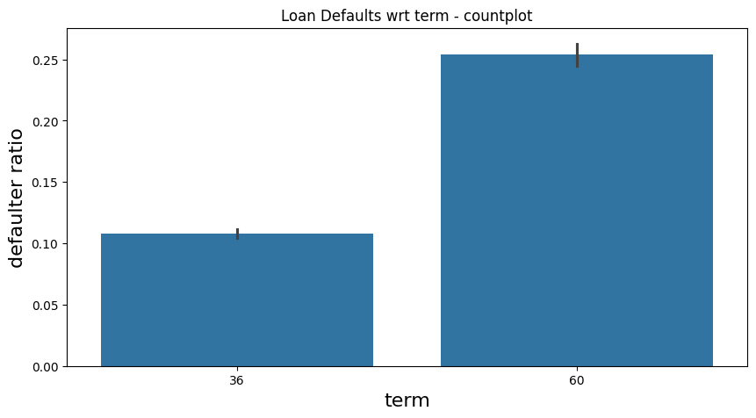
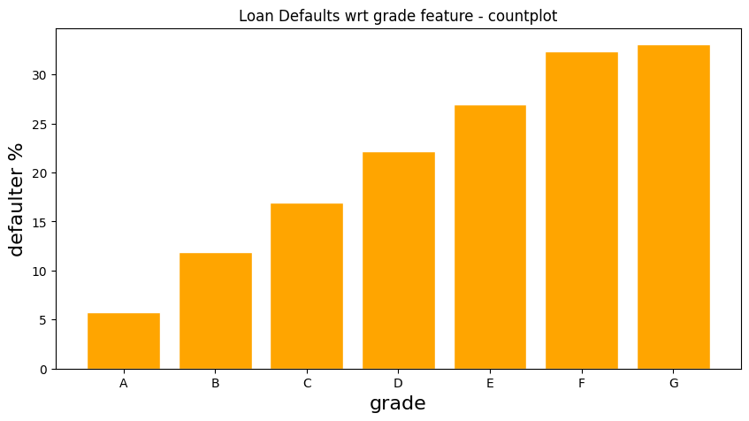
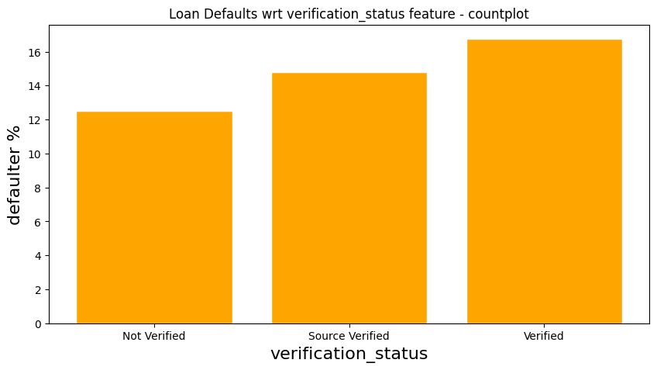
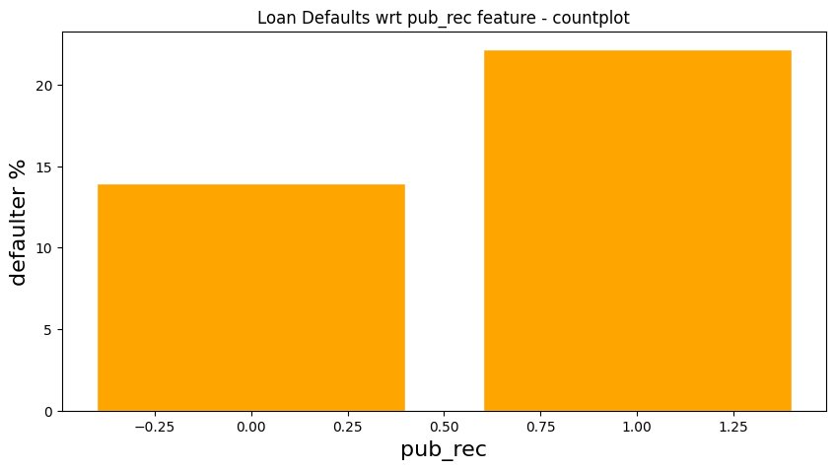
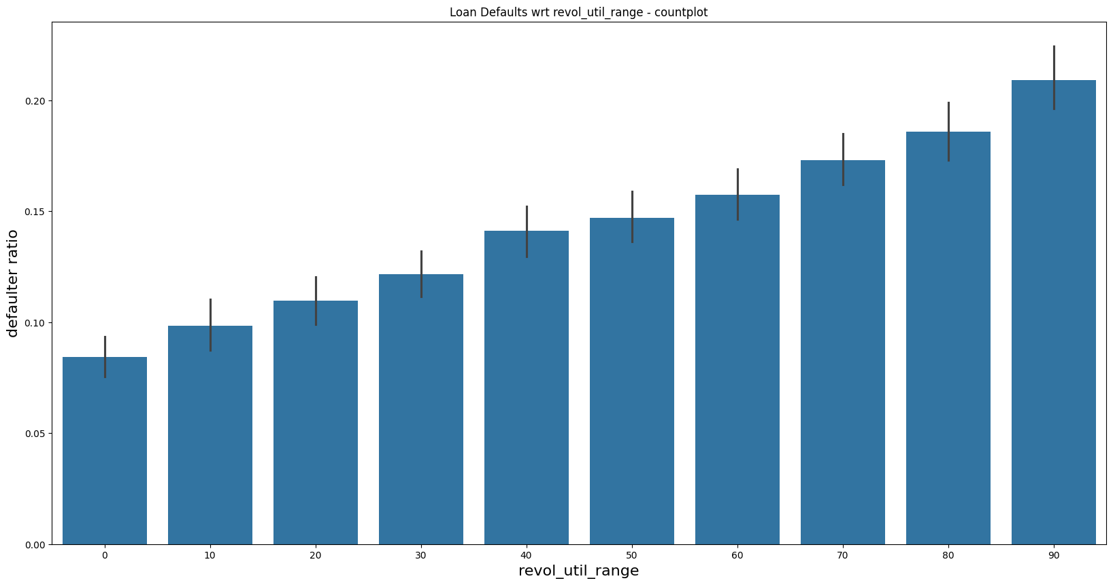
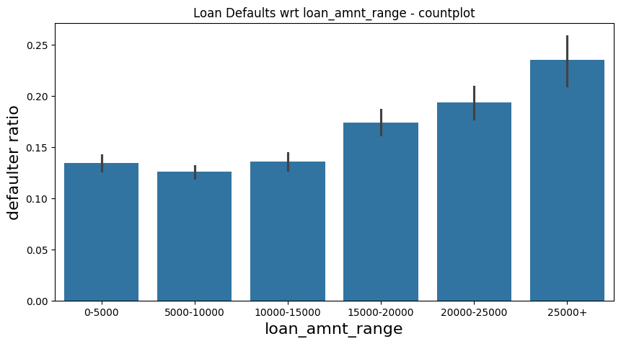
Univariate Analysis

Slide 15
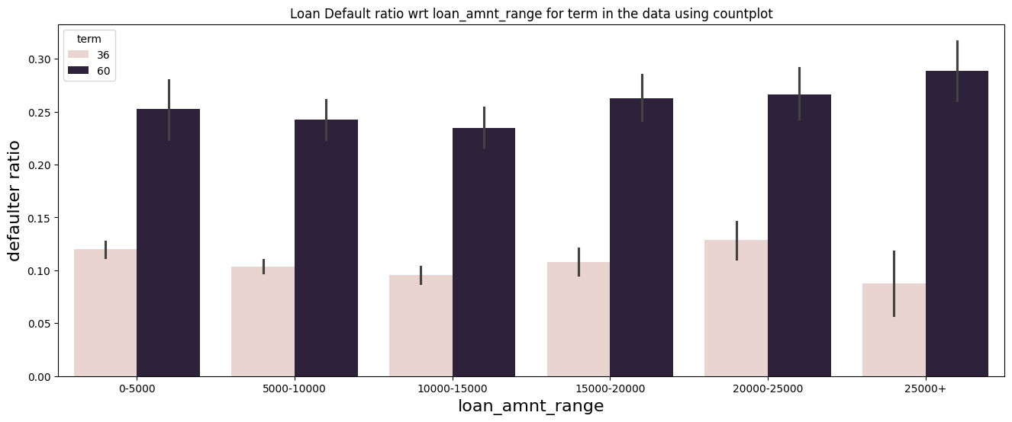
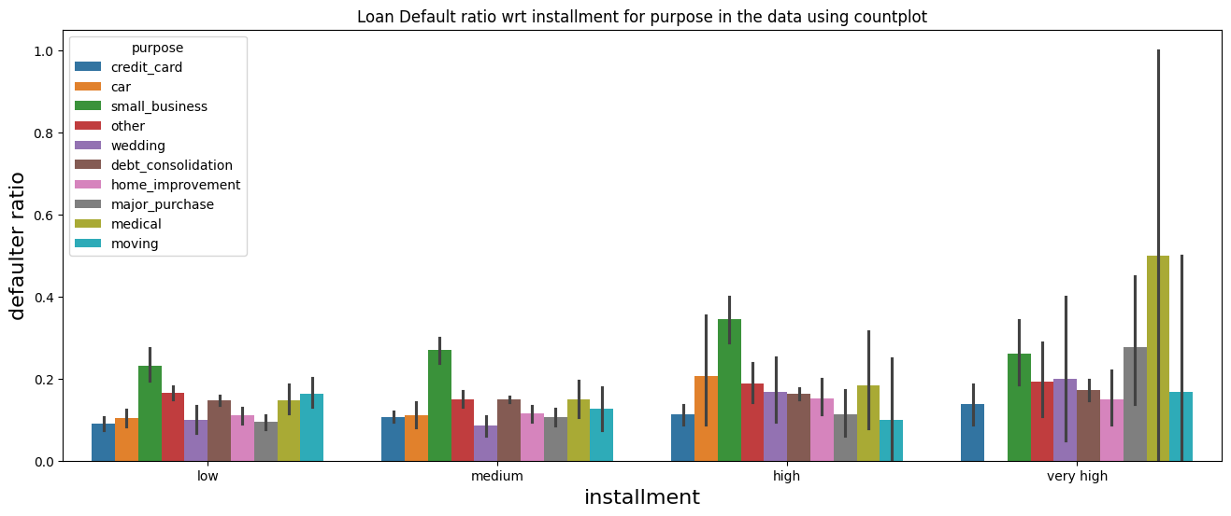
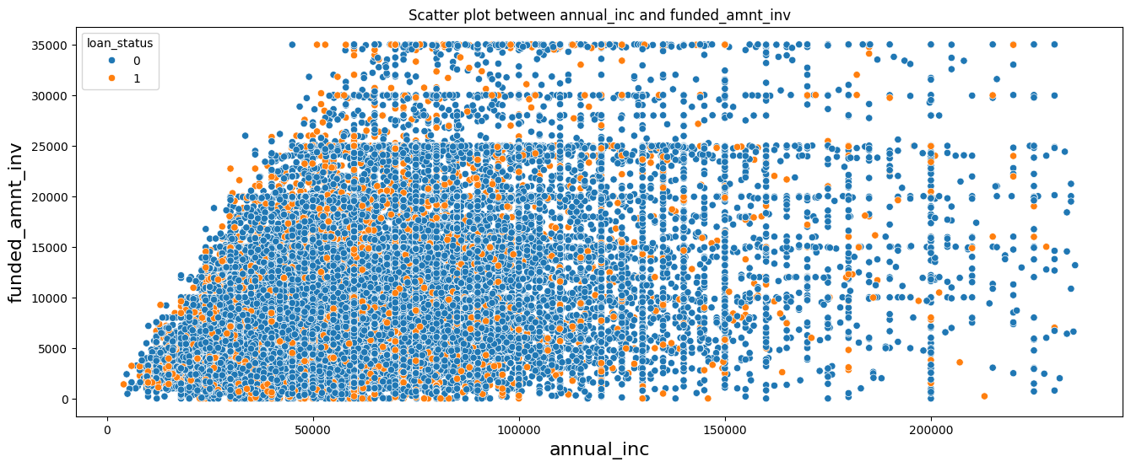
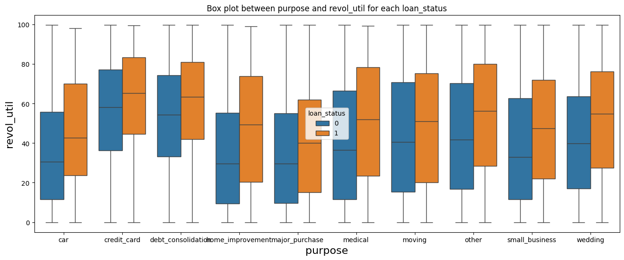
Bivariate Analysis

Slide 16
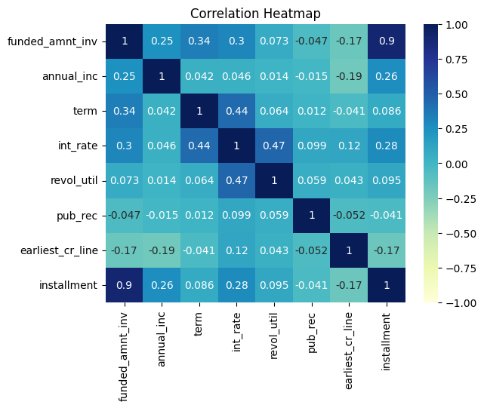
Multivariate Analysis

Slide 17
Inferences
Univariate Analysis
Defaulter rate is increasing with respect to term, grade, sub_grade, verification_status, pub_rec, pub_rec_bankruptcies, revol_util, loan_amnt, int_rate, installment.
Defaulter rate is decreasing with annual_inc.
We have seen that grade D, E, F, G has ~23% total loan however chances of being defaulted is also high here and cover 40% of total defaulters. Hence it makes sense to reject loans for borrowers in these three categories. Hence `grade` can become a deciding variable for loan approval.
Small_business has higher defaulter rate among other purposes.
Bivariate Analysis
Defaulter ratio increases for every purpose with respect to term, grade and loan_amnt, annual_inc.
Multivariate Analysis
There is no stronger correlation with columns which greatly affects loan_status.

Slide 18
Result
As per dataset analysis, below variables can be driving factors for loan approval process
Term
Grade
Purpose
Revolving line utilization rate (revol_util)
Interest rate
Installment
Annual income
Public Record
Public Record for bankruptcies
Funded amount by investors

Slide 19
Recommendations
As per dataset analysis, below points might be considered for loan approval process
Implement Stricter Criteria for Grades E, F and G.
Evaluate and Limit 60-Month Loans
Review Verification Process as from dataset it is observed that verified loans are more defaulted.
Adjust Interest Rates Based on DTI Ratios
Consider Annual Income Levels for Affordability
Check for public records for bankruptcies

Slide 20
Team
Raman Pandey
Rajeev Ranjan

